Slide 1


Android Lecture #9
GridVIew, Calendar

Slide 2


Index
GridView
Calendar

Slide 3

1. GridView
GridView
GridView

Slide 4

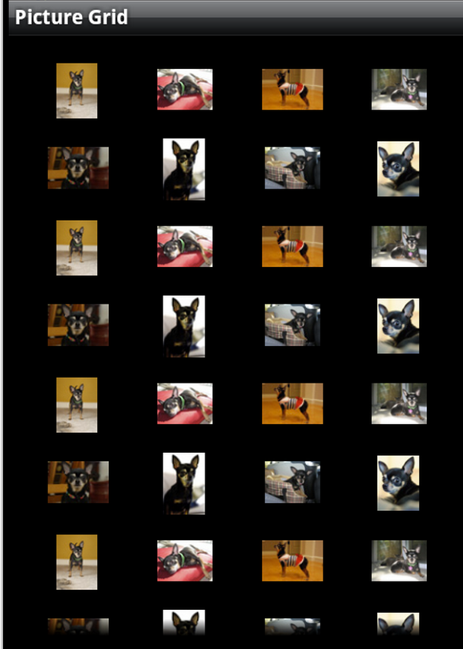
1. GridView
GridView
Grid
a grating of crossed bars
Android GridView shows items in two-dimensional scrolling grid (rows & columns
Grid items are not necessarily predetermined
They automatically inserted to the layout using a ListAdapter
ListAdapter : Extended Adapter that is the bridge between a ListView and the data that backs the list.

Slide 5
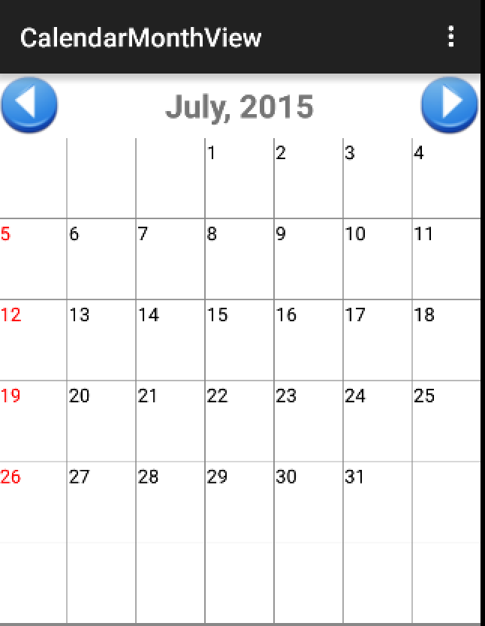
2. Calendar
Calendar
Previous Button
(June, 2015)
Next Button
(August, 2015)

Slide 6
2. Calendar
GridView Processing
Define layout (XML file) for each item
Define view(Java file) for each item
and make viewgroup
Define adapter class that can manage data
and define getView() method that return item view
Define item(data) and item view
Connect MainActivity to other view

Slide 7
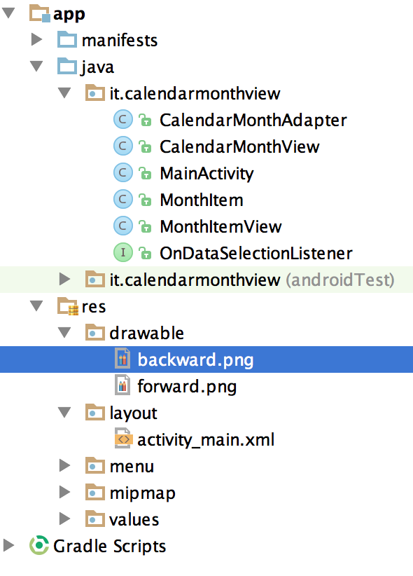
2. Calendar
Project Component
1. Layout
2. CalendarMonthView
3. OnDataSelectionListener
3. CalendarMonthAdapter
4. MonthItemView
5. MonthItem
6. MainActivity

Slide 8
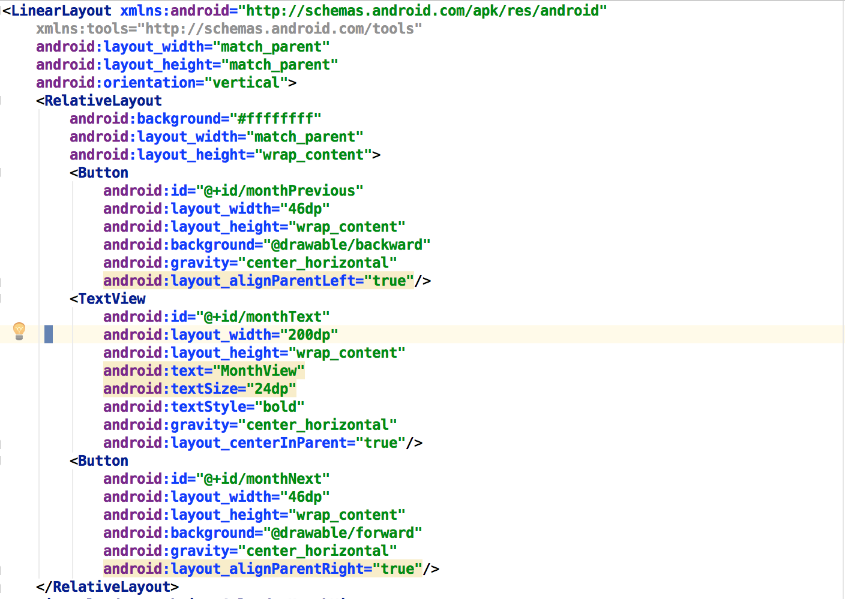
2. Calander
Layout(activity_main.xml)

Slide 9
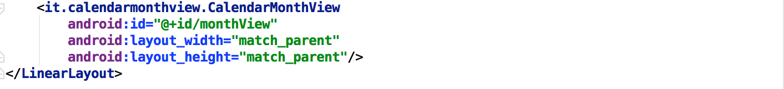
2. Calander
Layout(activity_main.xml)

Slide 10
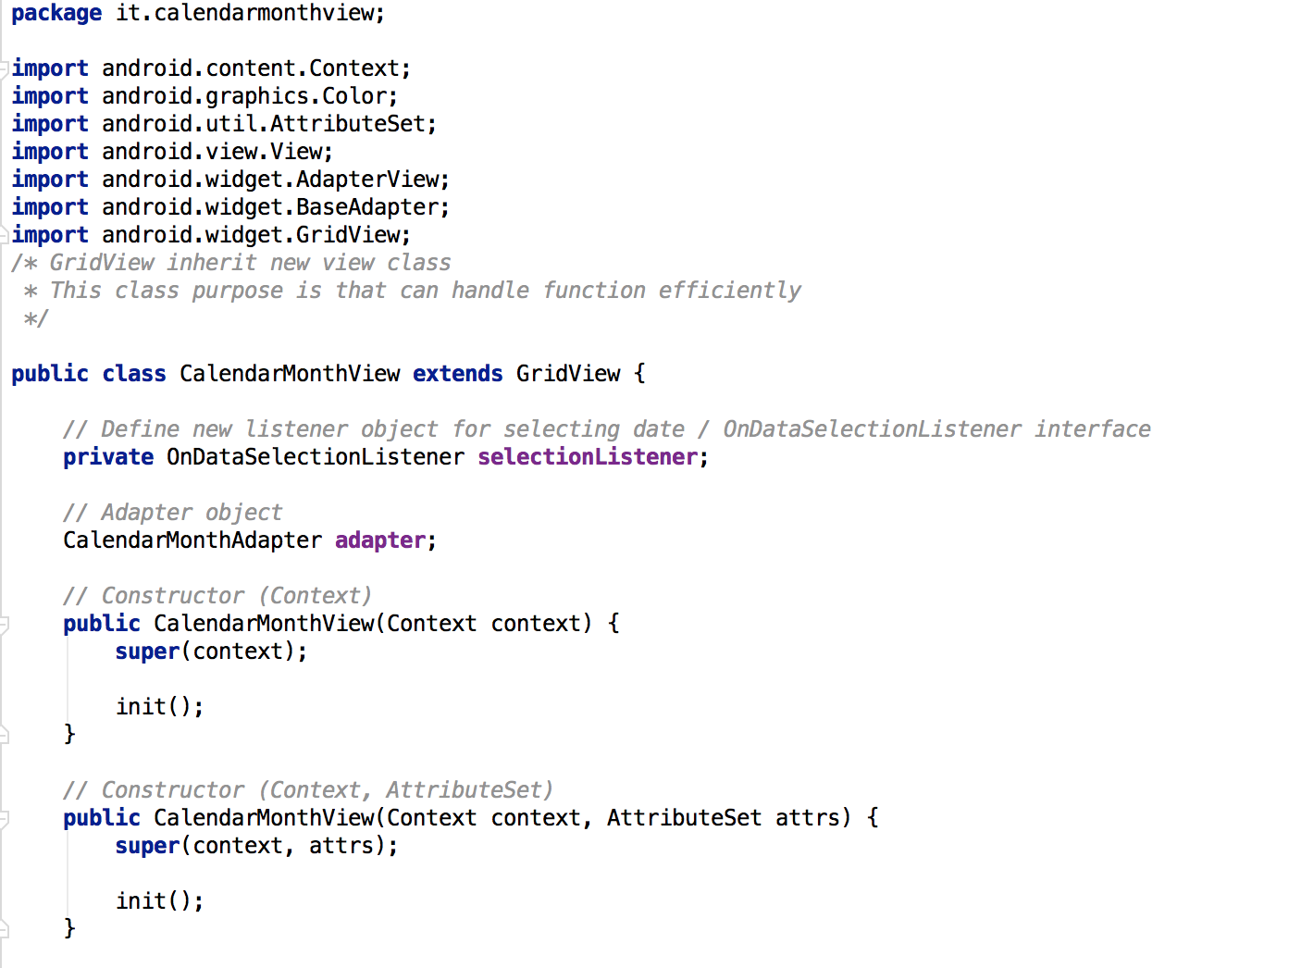
2. Calander
CalendarMonthView.java

Slide 11
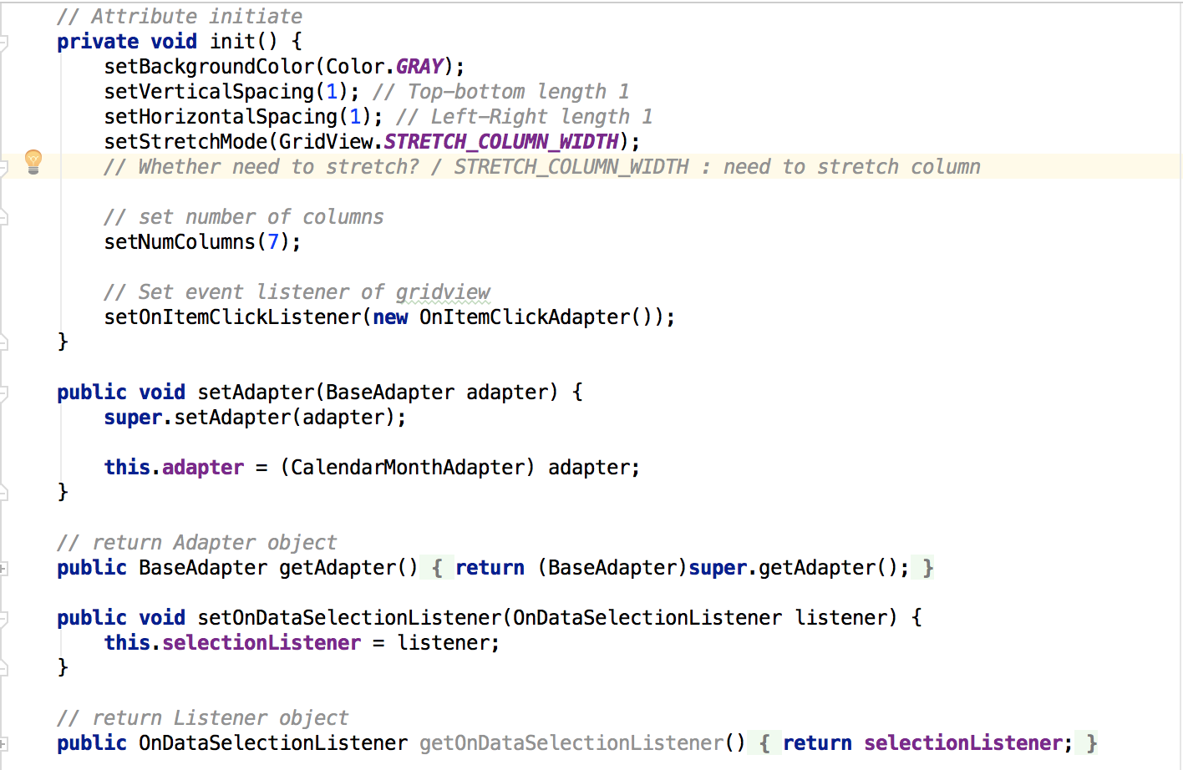
2. Calander
CalendarMonthView.java

Slide 12
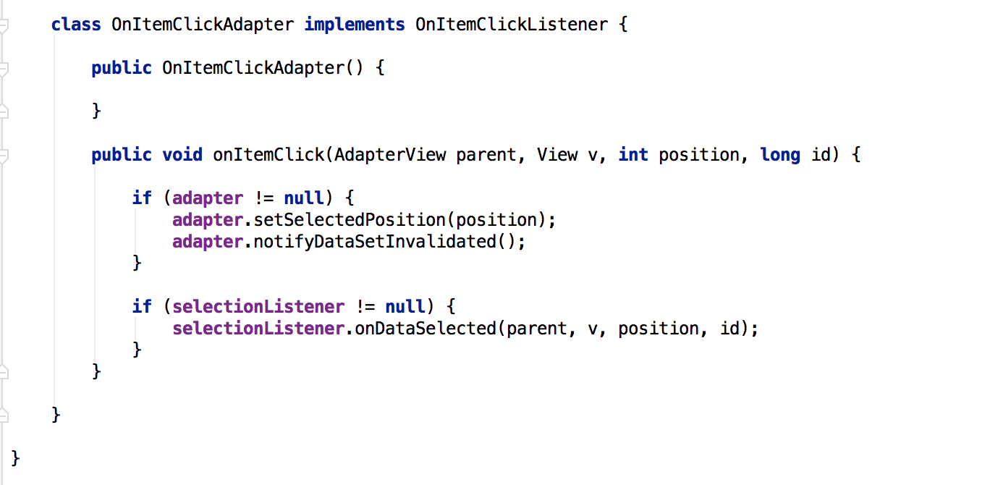
2. Calander
CalendarMonthView.java

Slide 13
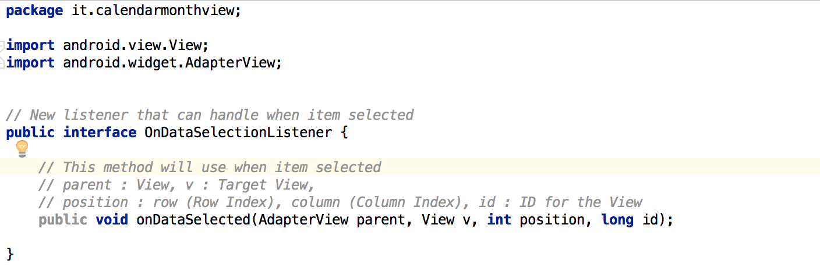
2. Calander
OnDataSelectionListener.java

Slide 14
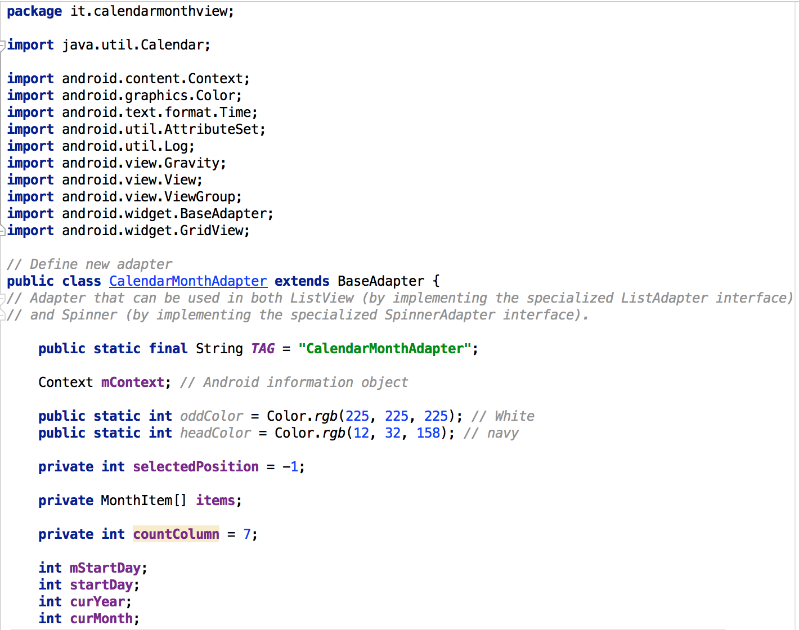
2. Calander
CalendarMonthAdapter.java

Slide 15
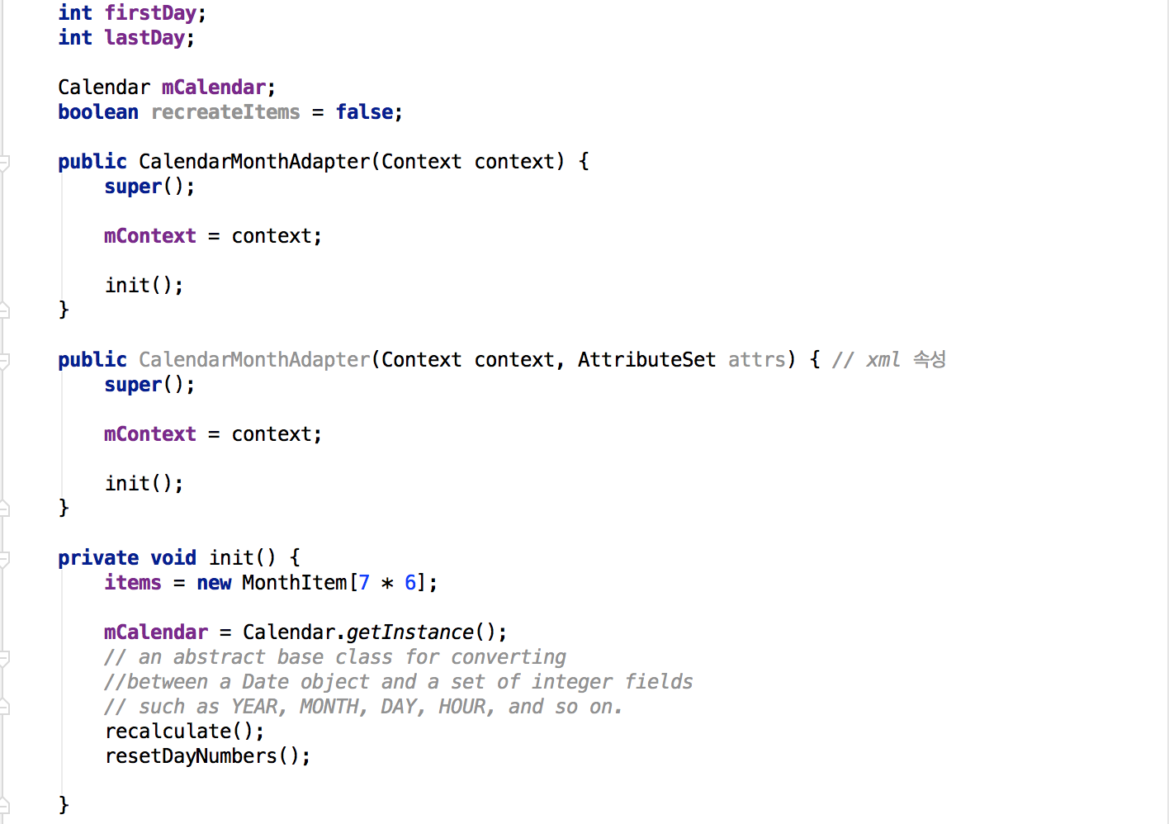
2. Calander
CalendarMonthAdapter.java

Slide 16
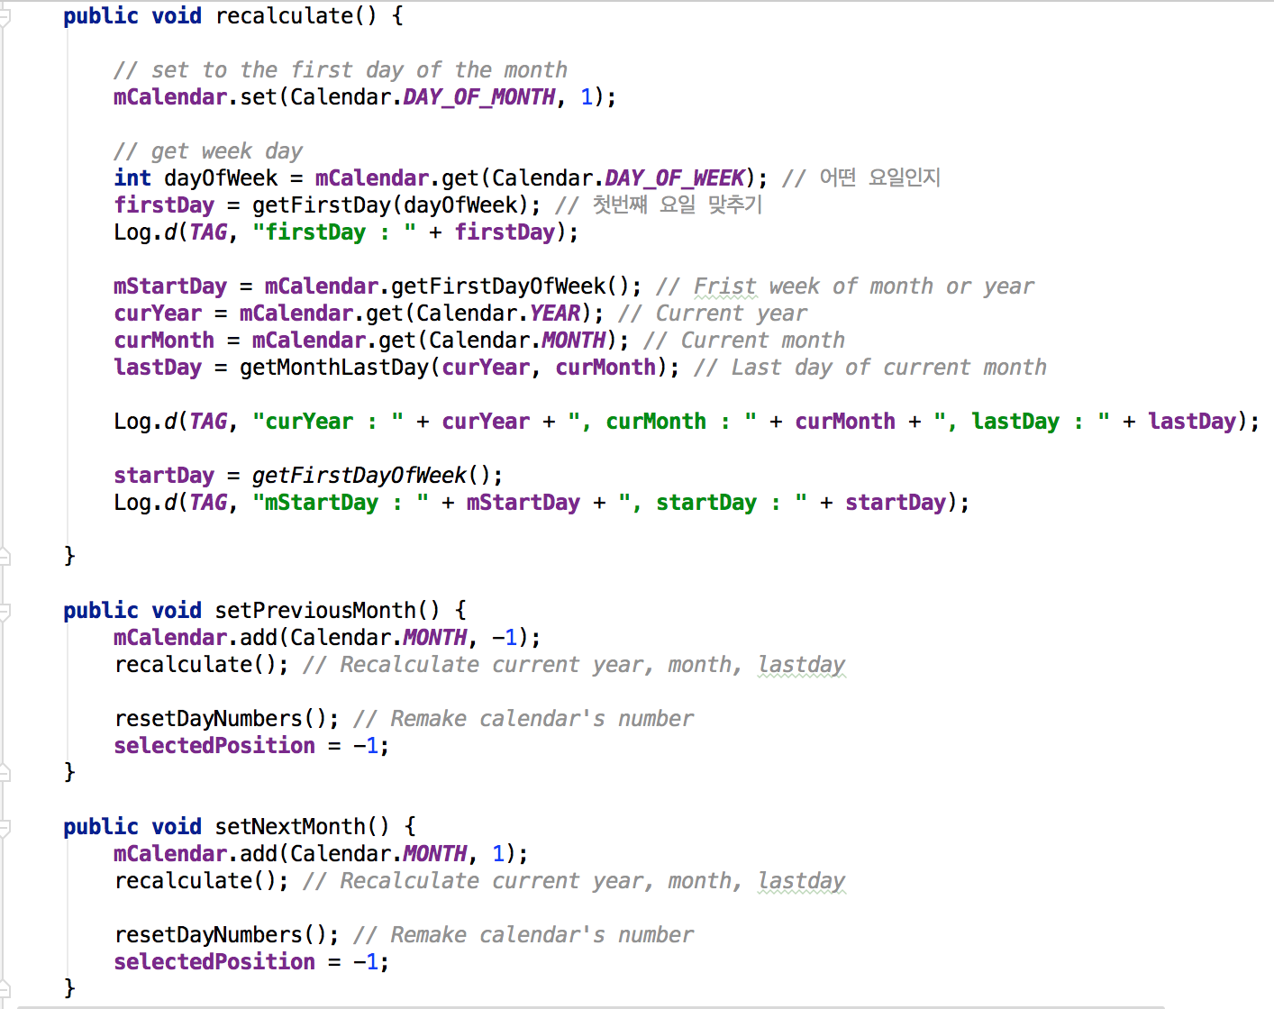
2. Calander
CalendarMonthAdapter.java

Slide 17
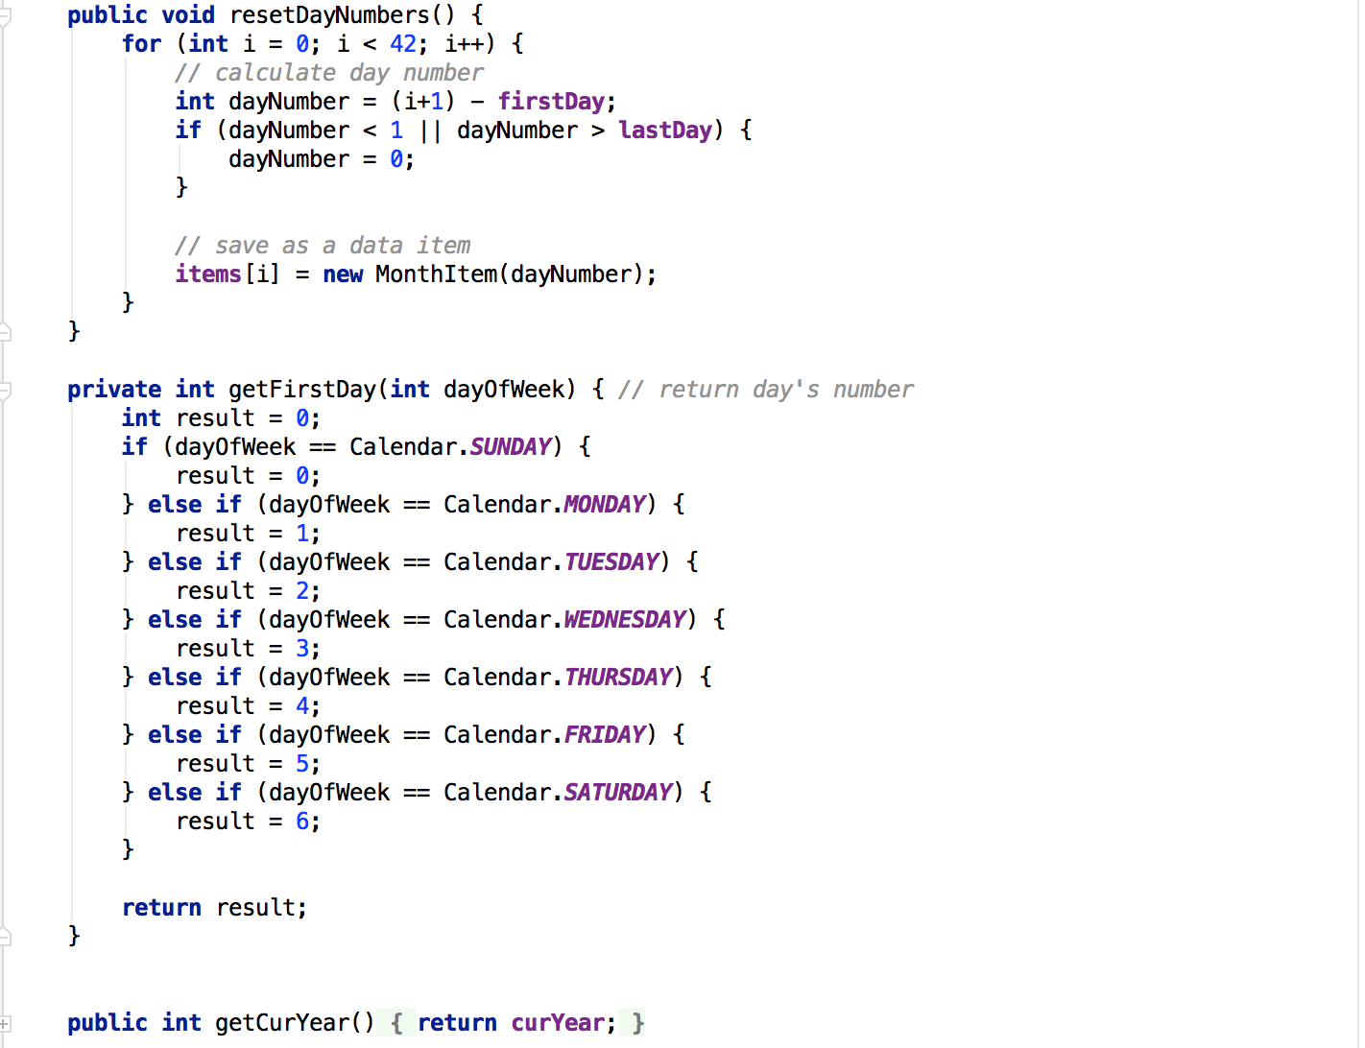
2. Calander
CalendarMonthAdapter.java

Slide 18
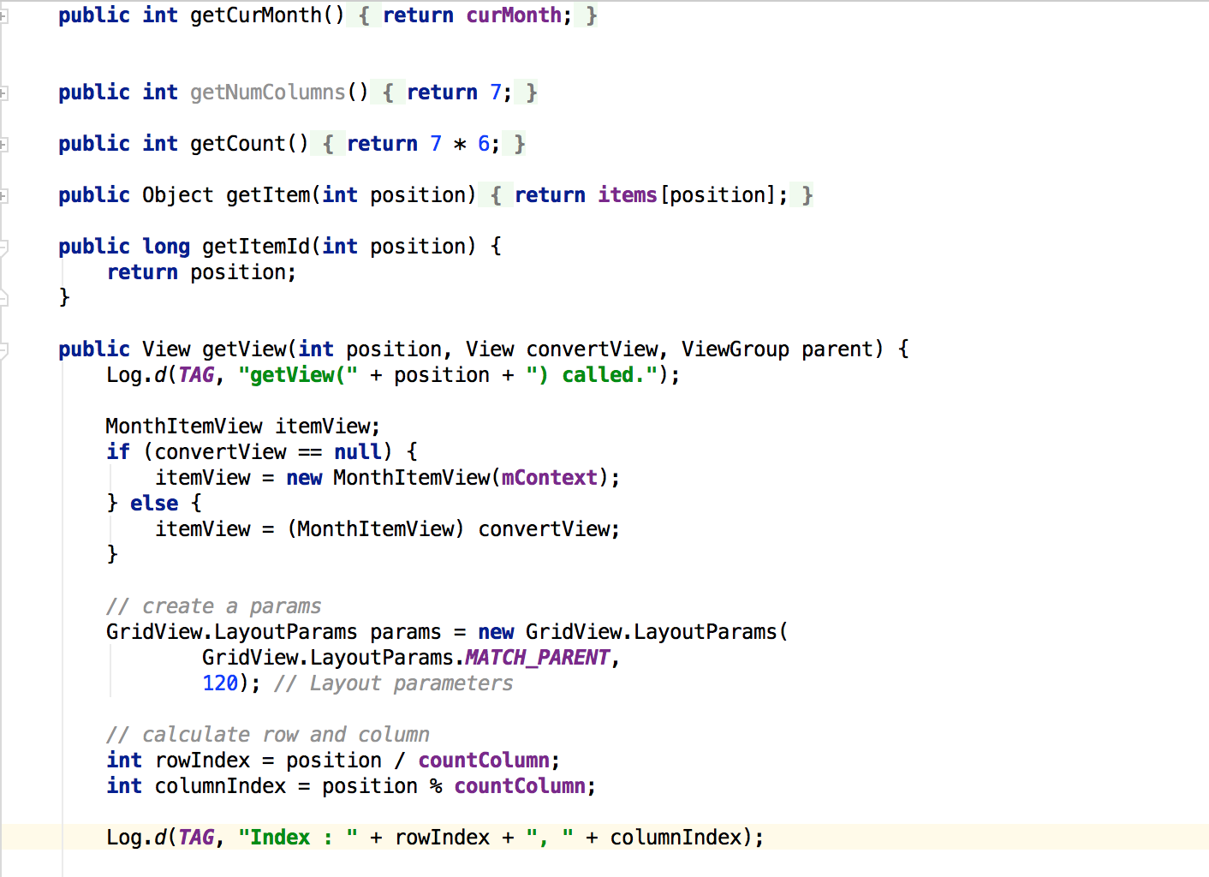
2. Calander
CalendarMonthAdapter.java

Slide 19
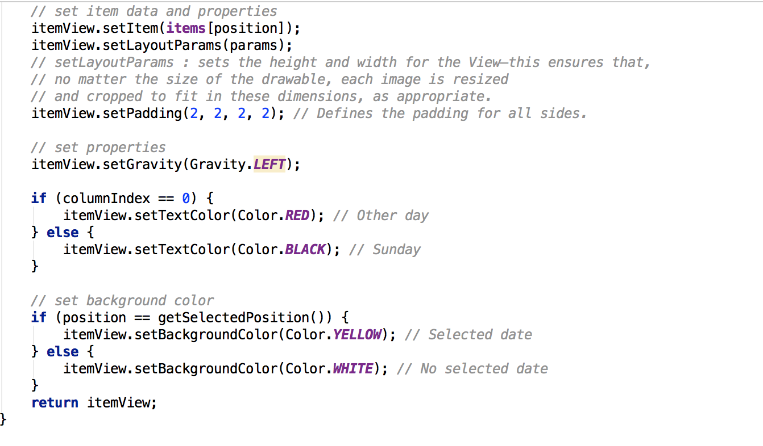
2. Calander
CalendarMonthAdapter.java

Slide 20
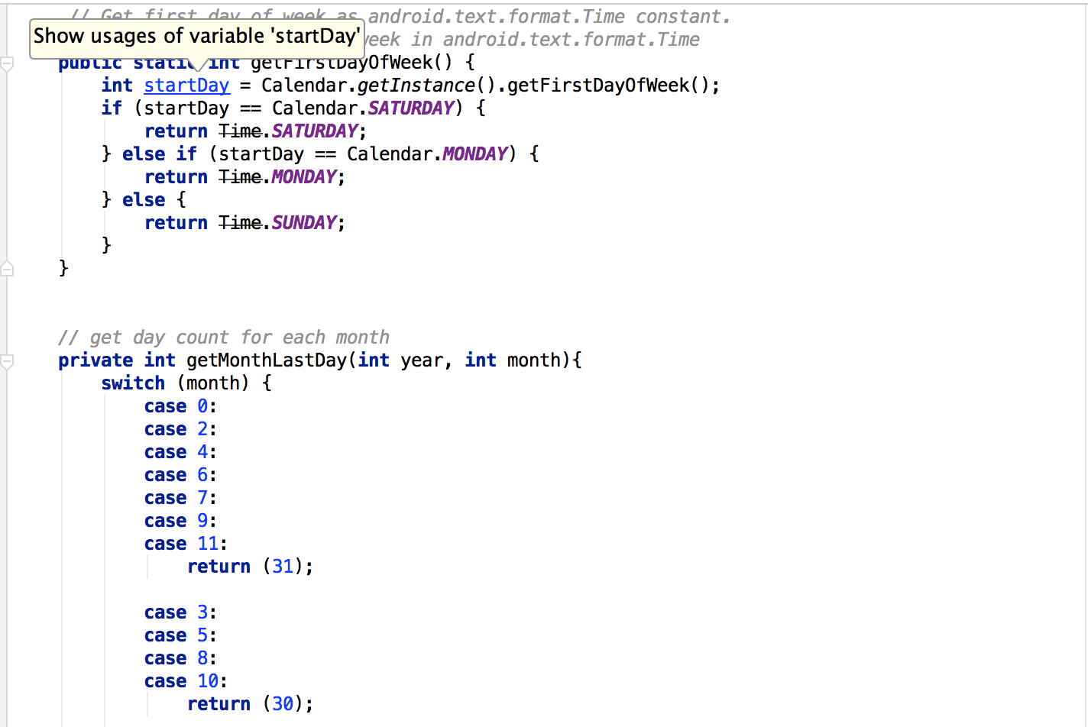
2. Calander
CalendarMonthAdapter.java

Slide 21
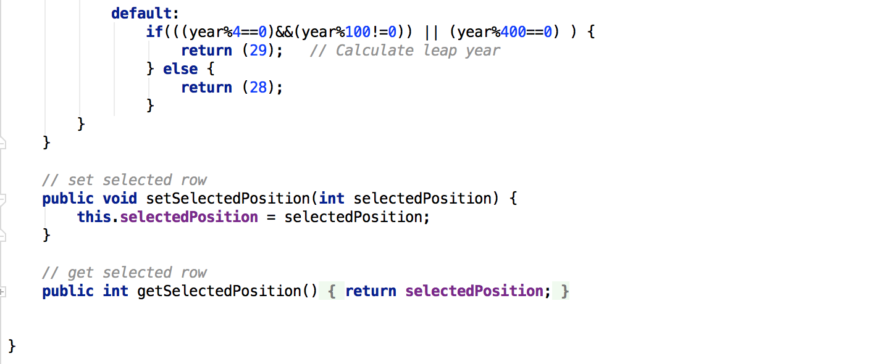
2. Calander
CalendarMonthAdapter.java

Slide 22
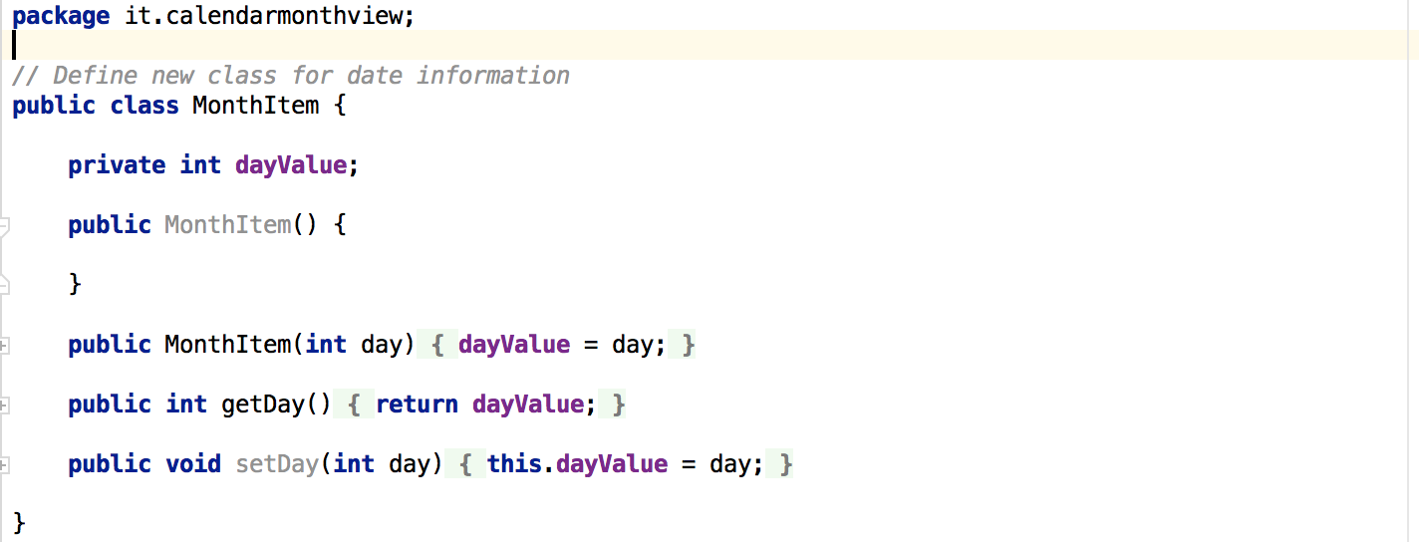
2. Calander
MonthItem.java

Slide 23
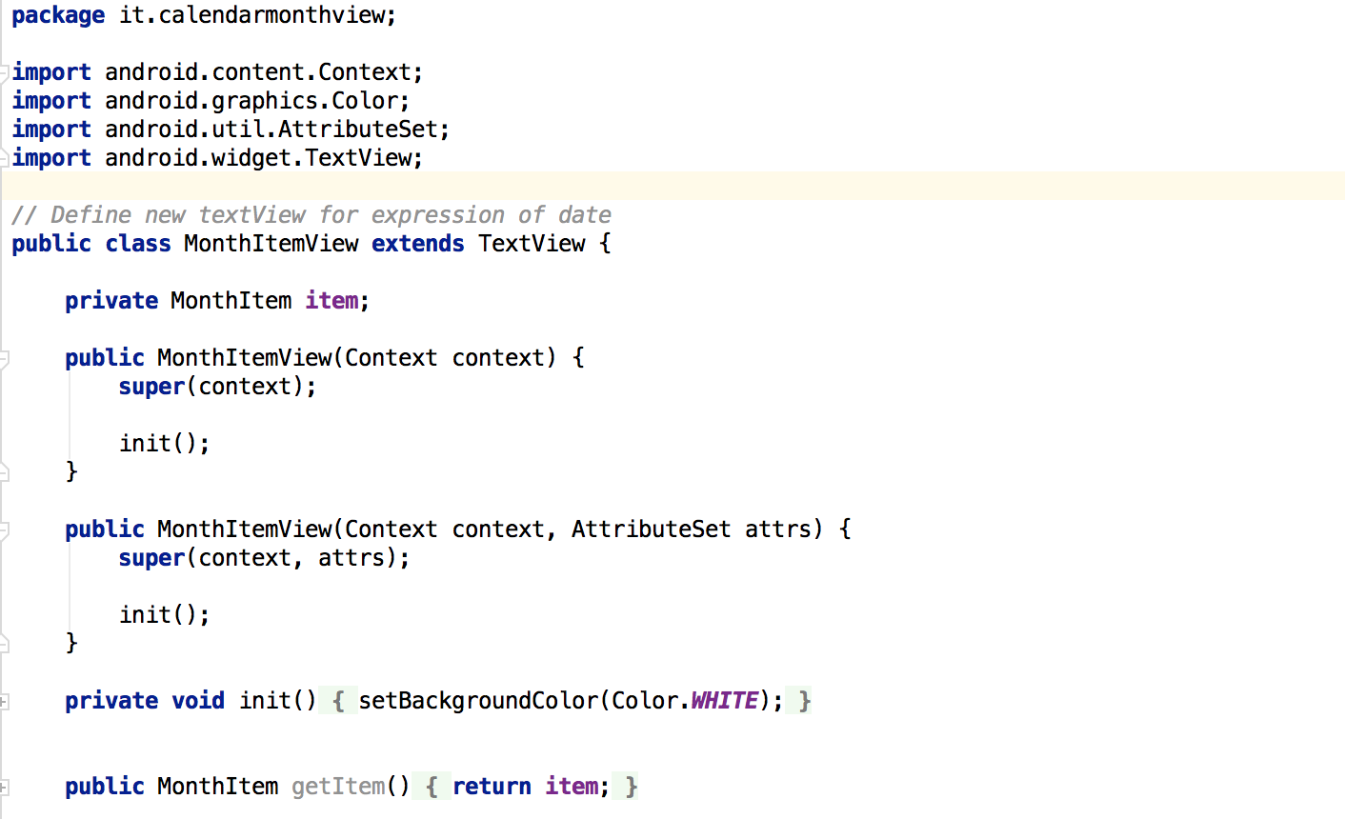
2. Calander
MonthItemView.java

Slide 24
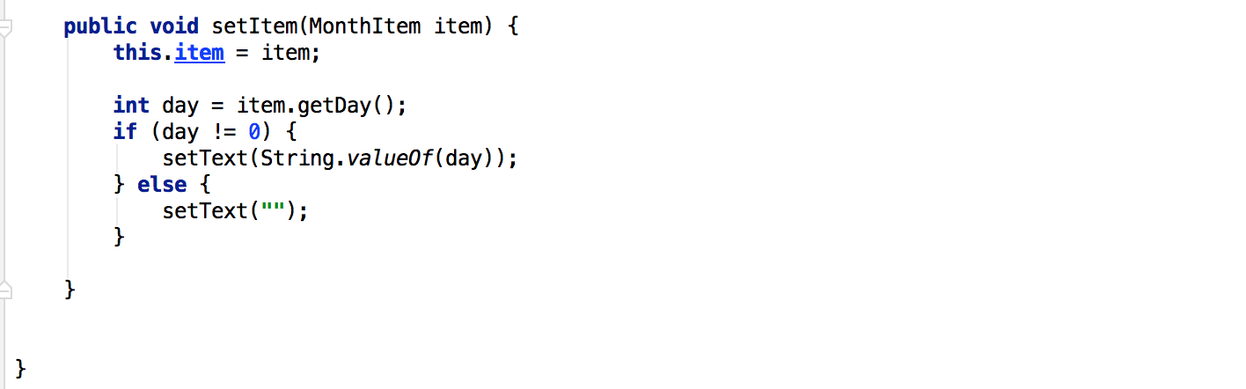
2. Calander
MonthItemView.java

Slide 25
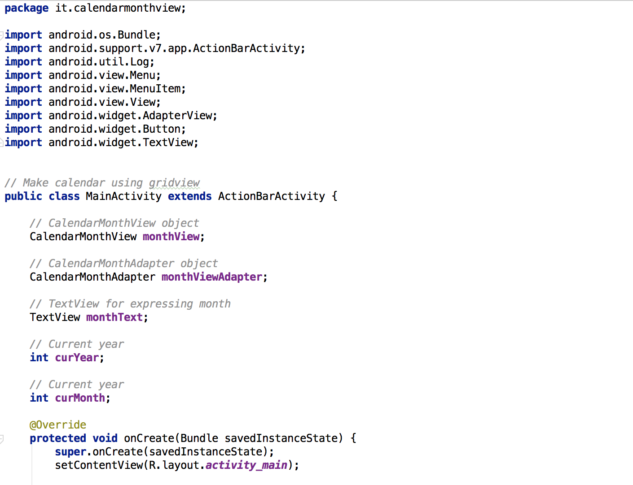
2. Calander
MainActivity.java

Slide 26
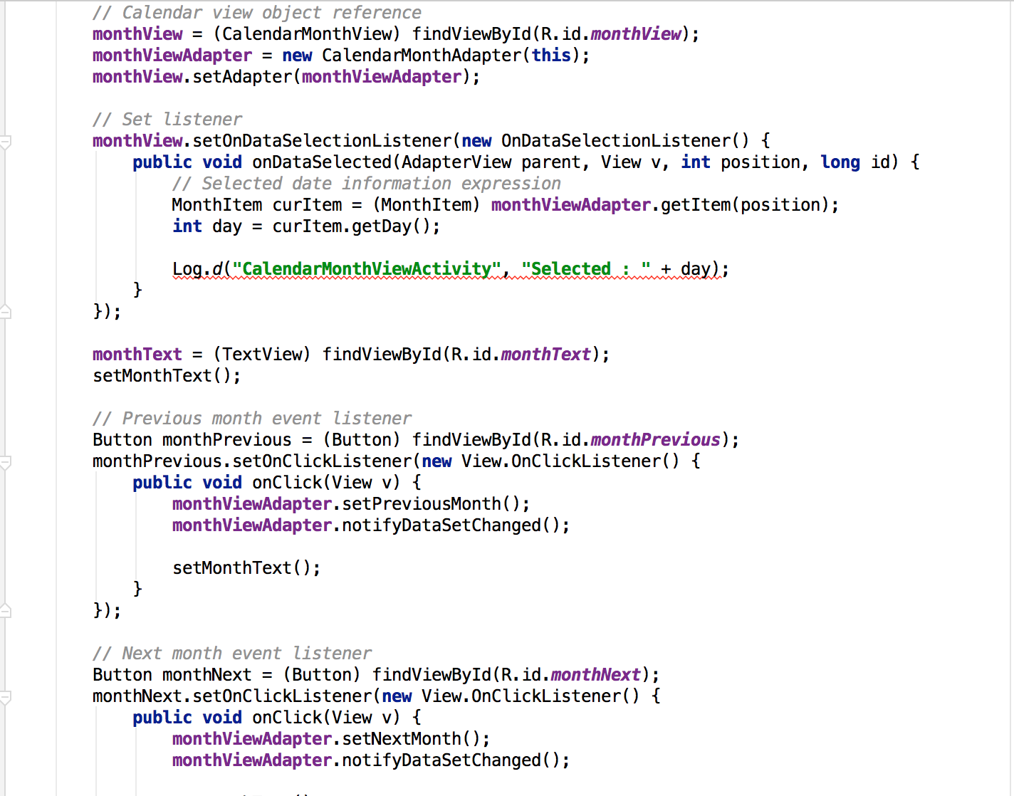
2. Calander
MainActivity.java

Slide 27
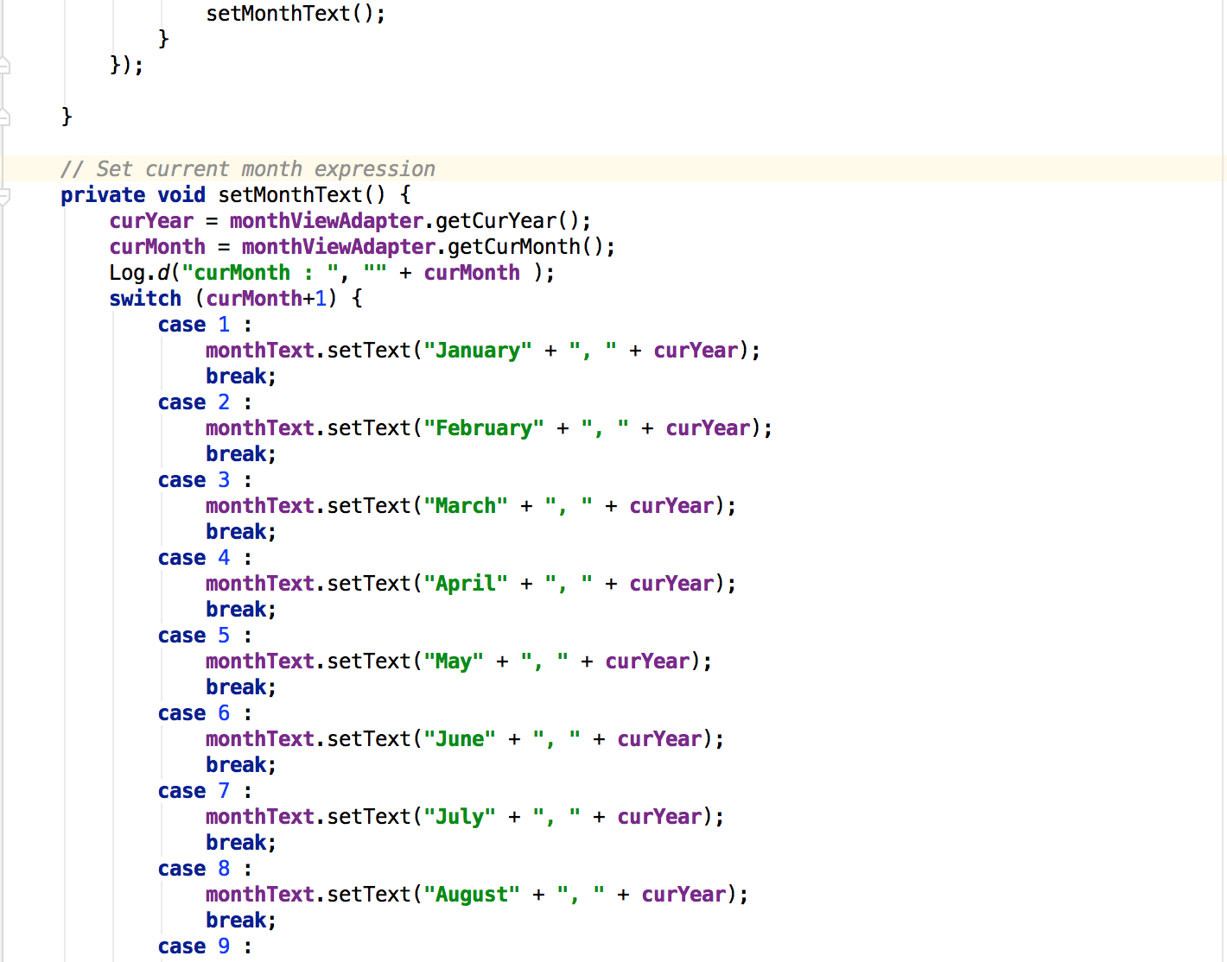
2. Calander
MainActivity.java

Slide 28
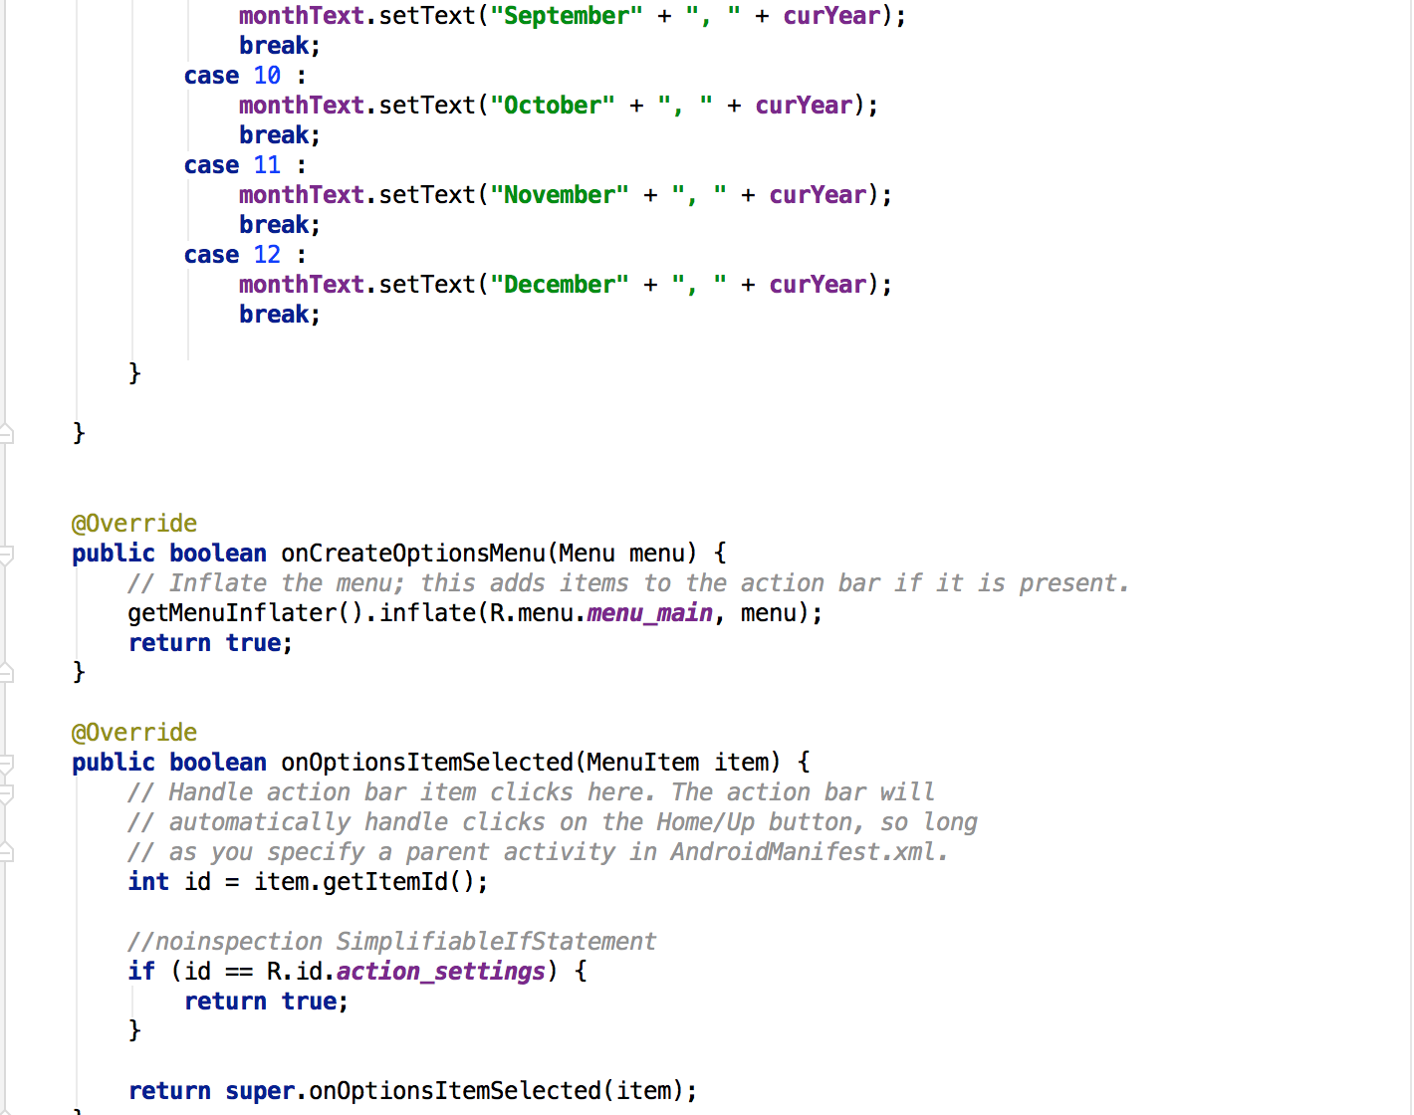
2. Calander
MainActivity.java

Slide 29
Thank you!

